Slide 1
How WorldVisitz
can benefit from Agile
An Agile transition guide by Davide Nastri
Notes:
Good day everyone and thank you for being here today. My name is Davide Nastri and I am an Agile consultant, I am here as a coach to help you in launching your new mobile application solution. I hope that we will remember today as the day that begun WorldVisitz’s Agile Transformation. (Change slide)

Slide 2

What is
?
Notes:
(Read slide) Agile is an iterative approach to project management and software development that helps teams deliver value to their customers faster and with fewer headaches. Agile enables organizations to master continuous change, it permits them to flourish in a world that is increasingly volatile, uncertain, complex and ambiguous.
Agile is really about thinking through how organizations can understand what’s going on in the environment that they’re in today, identify what uncertainty they’re facing, and figure out how they can adapt to that as they go along.

Slide 3

The Agile Manifesto
“We are uncovering better ways of developing software by doing it and helping others do it.
Through this work we have come to value: Individuals and interactions over processes and tools Working software over comprehensive documentation Customer collaboration over contract negotiation Responding to change over following a plan
That is, while there is value in the items on the right, we value the items on the left more.”
Notes:
I am pleased to read with you the Agile Manifesto. (Read slide) It is important to follow the Agile Manifesto Principles because they summarize easily the key behaviors that can lead to customer and team satisfaction. Having the right group of individuals on your software team is vital to success. The best possible tools in the wrong hands are worthless. Perhaps even more important is how these individuals communicate with each other. The interactions between team members are what helps them to collaborate and solve any problems that arise.

Slide 4
The benefits of Business Agility over Waterfall to WorldVisitz.
Notes:
Current way of working in WorldVisitz is Waterfall. Let’s briefly analyze which are the benefits of business agility over Waterfall to WorldVisitz.

Slide 5

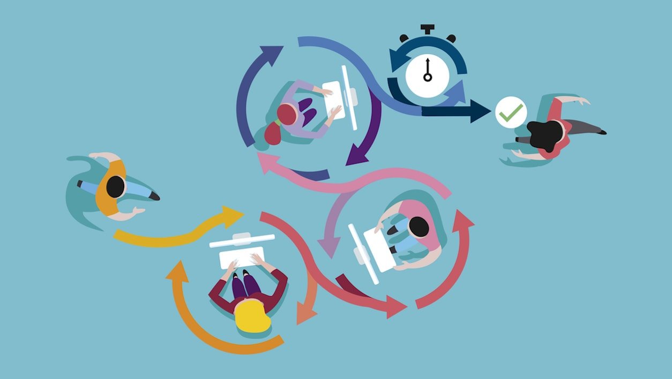
Agile is a more effective solution than Waterfall to WorldVisitz.
Here’s a brief comparison of their key differences:
Agile is an incremental and iterative approach; Waterfall is a linear and sequential approach.
Agile separates a project into sprints; Waterfall divides a project into phases.
Agile helps complete many small projects; Waterfall helps complete one single project.
Agile introduces a product mindset with a focus on customer satisfaction; Waterfall focuses on successful project delivery
Requirements are prepared everyday in Agile, while requirements are prepared once at the start in Waterfall
Notes:
(Read and comment briefly the bullet points) Agile uses engineering principles in tackling a big and complex problem dividing it into smaller, simpler problems that become completed in an easier way. It also promotes a product mindset and has customer satisfaction in very high regard. Requirements are prepared daily because in the modern, kinetic, chaotic world requirements can also change daily.

Slide 6
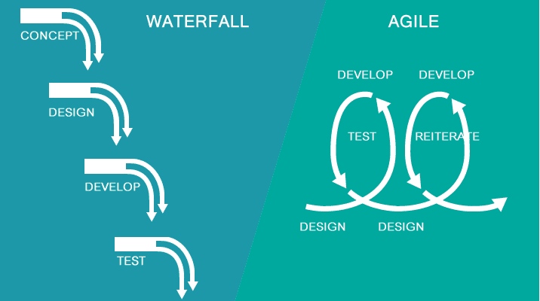
Agile allows requirement changes at any time; Waterfall avoids scope changes once the project starts
Testing is performed concurrently with development in Agile; testing phase comes only after the build phase in a Waterfall project
Test teams in Agile can take part in requirements change; test teams in Waterfall do not get involved in requirements change
Agile enables the project team to operate without a dedicated project manager; Waterfall requires a project manager who plays an essential role in every phase.
Notes:
Agile allows and nurtures flexibility, pushes for continuous feedback, thrives in new requirements and in how to quickly adapt, build, test and deliver again. As a single living creature the agile team is independent, exposed to all the inputs and can therefore react harmonically with a strong choral push in the same direction.

Slide 7

Using Agile allows WorldVisitz to improve application delivery over Waterfall.
Here’s some practical examples…
Notes:
One of the Agile key elements that will enable the success of the new project is improving application delivery. Let’s look at some practical examples…

Slide 8
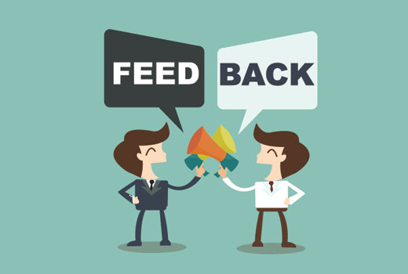
Customer feedback is received late, in market testing and after product launch
The original formulation of the first of the Agile principles says, "our highest priority is to satisfy the customer through early and continuous delivery of valuable software"
Notes:
In the bullet point you can read the important elements I have extracted from WorldVisitz case study. The first one is (read bullet point) How can Agile help in solving this issue? Feedback. Feedback in every stage, at every step. Feedback that allows to fail early, rearrange and get iteratively closer and closer to perfection. Which is the main feedback? The customer’s. How can Agile get that feedback often and quickly? (read Agile principle)

Slide 9
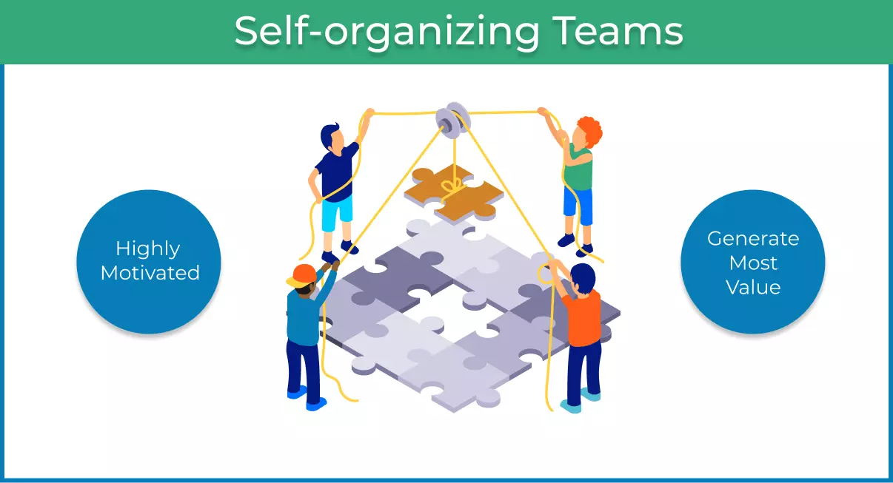
Work is primary planned by a single person that also assigns it to individuals based on preference
The 17 fathers of Agile stated that "the best architectures, requirements, and designs emerge from self-organizing teams"
Notes:
Here we have another excerpt by the case study. (read bullet point) When provided with freedom, motivated teams generate the most value for the customer.
Agile fully acknowledges this fact and is a true propellent to push the teams efficiently to reach the Self-organizing status. (read agile principle)

Slide 10
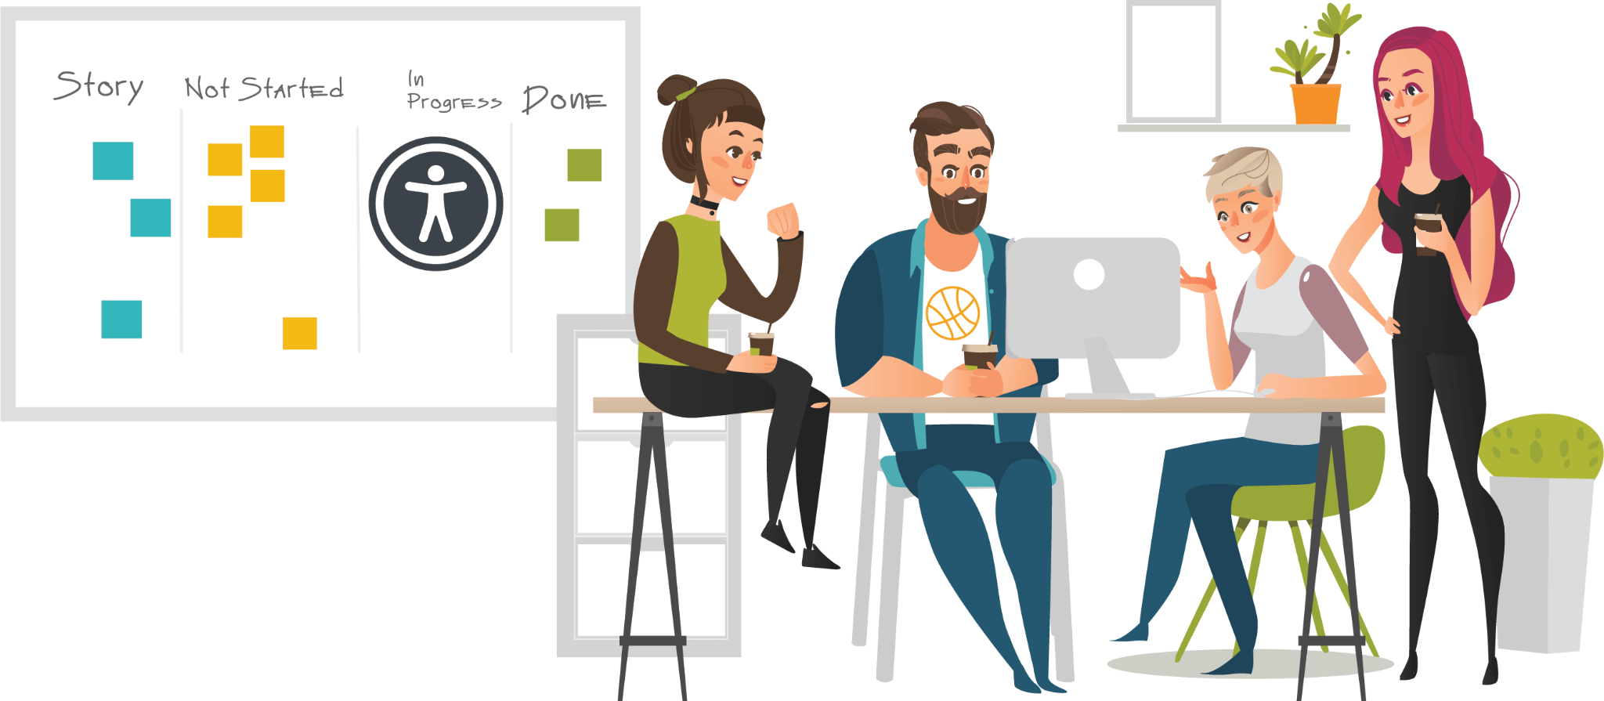
Preferring one-on-one interviews and calls and isolating the onshore and offshore teams. Business people detached from developers by process, department and facility boundaries
Agile relies on cross-functional teams to make communication easier between the different stakeholders in the project. As the original text states, "Business people and developers must work together daily throughout the project".
Notes:
I have left this information from the case study as last because for me is the most important and will be the most powerful driver in WorldVisitz Agile transformation. Agile will transform a group of individuals that are working on separate tasks used to achieve a common goal in a single entity, a True Agile Team. An Agile Team is able to use its collective brainpower in synergy with the perks of each individual constituting it. Not only the final result will be better and appreciated by the customer but the team will be closer, stronger, happier. This can happen because (Read agile principle)

Slide 11
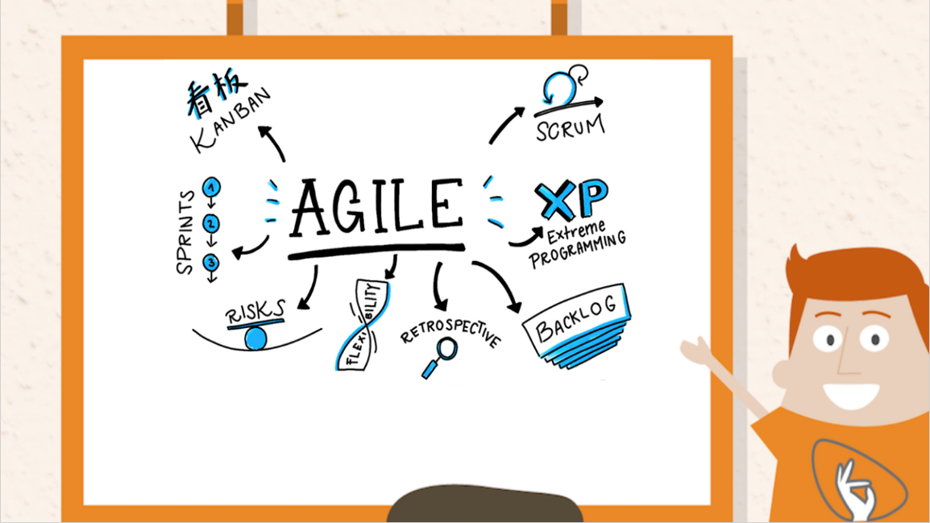
THE
FRAMEWORKS
Notes:
I hope you are curious and excited about diving into more details. How does Agile work? Which are its moving parts? Can we disassemble it? Agile is constituted by several entities. The frameworks are indeed some of the most important. Let’s analyze Agile Frameworks together.

Slide 12

Agile Umbrella
Scrum
Kanban
XP
Notes:
Agile includes three principal frameworks (Read frameworks)

Slide 13
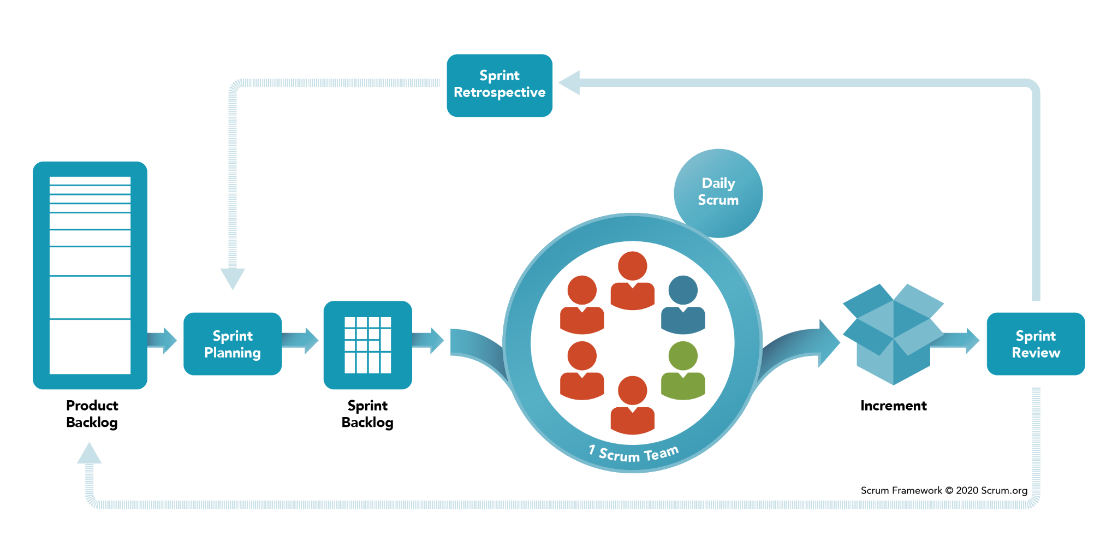
Scrum
Notes:
SCRUM was developed by Jeff Sutherland and Ken Schwaber in the early 90s.
In simple terms, Scrum breaks down organisations into small, self-organising teams. These teams then break the features they’ve been tasked with delivering down into small, manageable items of work which they tackle in time-boxed iterations called sprints.
The most prescriptive of the three frameworks considered in this post, Scrum insists that teams comprise of three distinct roles – the Product Owner, the ScrumMaster and dev team members.
There are also four prescribed meetings in Scrum: the Sprint Planning Meeting, the Daily Stand Up, the Sprint Review and the Sprint Retrospective.

Slide 14
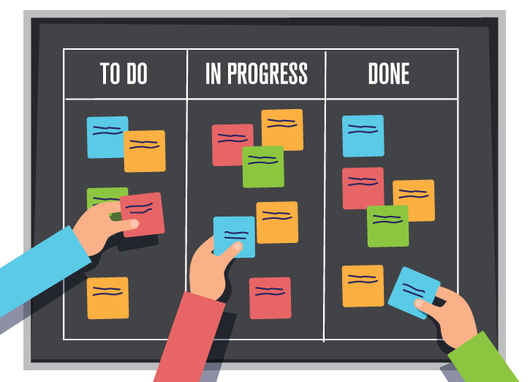
Kanban
Notes:
Kanban developed as a subcomponent of the Toyota Production System and has its origins in these Lean and Just In Time (JIT) manufacturing processes.
In Kanban the workflow is visualised: work is broken down into small, discrete items and written on a card which is stuck to a board; the board has different columns and as the work progresses through different stages (e.g. ready, in progress, ready for review etc) the card is moved accordingly.
In Kanban the number of items that can be in progress at any one time is strictly limited.
The average time it takes to complete an item (sometimes called the ‘cycle time’) is tracked and optimised so that the process becomes as efficient and predictable as possible. The elimination of waste is paramount.

Slide 15
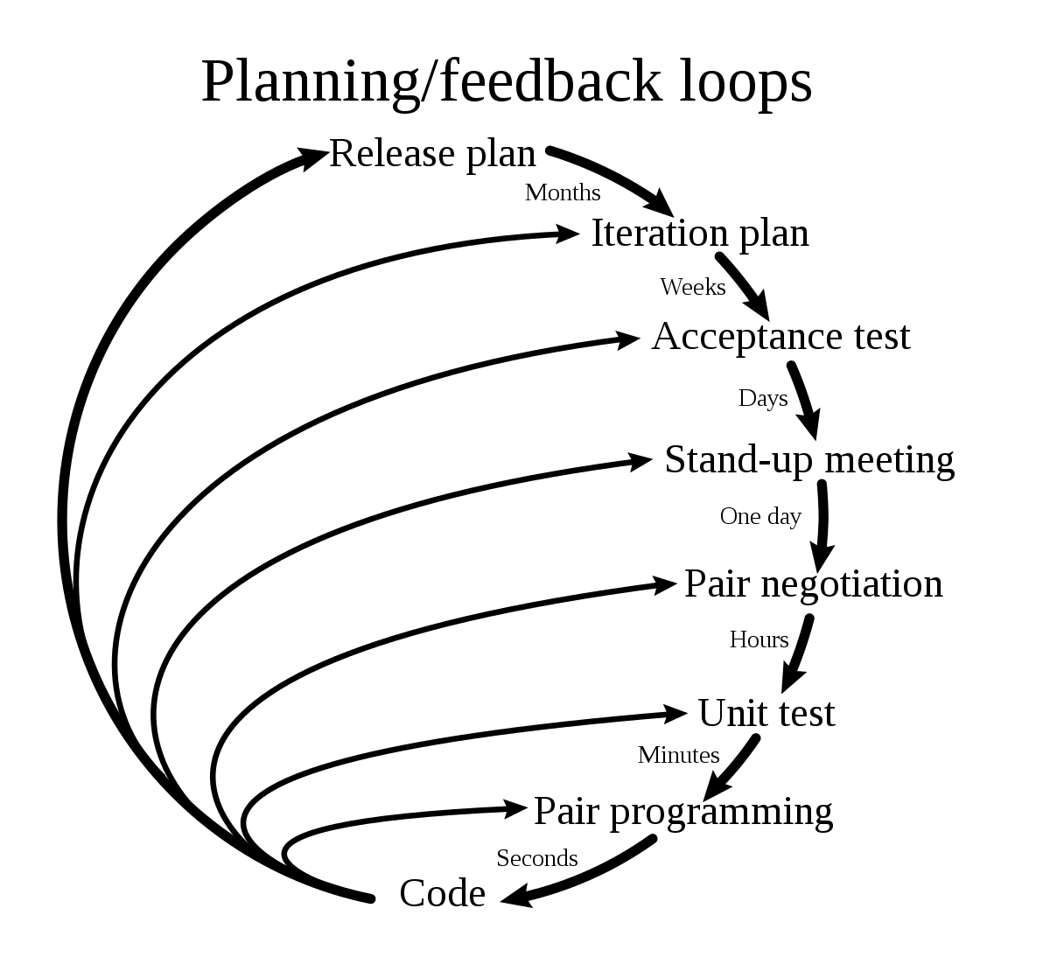
XP
Notes:
XP is short for eXtreme Programming, a framework which focuses heavily on ensuring the quality of delivered software and which prescribes engineering solutions towards that end.
An XP team (comprised of all who contribute to the project) engage in Release Planning and Iteration Planning. They work in very short development cycles so that changes requested by the customer (who works on-site with the team) can be incorporated frequently.
Through more than a dozen core practices which include Test Driven Development, Customer Testing, Continuous Integration, Small Releases and Pair Programming, XP works towards a continuously improving, high quality product which can respond to changes in customer requirements.

Slide 16
The recommended framework for WorldVisitz is
Scrum
Notes:
At this point I would imagine your question is… Ok, those frameworks are very interesting but… Which is the right solution for WorldVisitz? Well, everyone can clearly see on the screen my answer: Scrum. Allow me to explain why I took this decision analyzing 3 key business challenges that WorldVisitz is facing (change slide)

Slide 17
Three key business challenges WorldVisitz is facing
Customer feedback is received late
The Team is not working closely together, both physically and spiritually
Requirements and product planning are conducted upfront
Notes:
Read the slide

Slide 18
How Scrum can solve those challenges
Scrum ceremonies are built around the concept of early feedback loop
A Scrum Board helps a team plan their work together and stay focused on the Sprint goal
In Scrum change is the norm, and requests are re-prioritized at Sprint boundaries
Notes:
Read the slide
As you can see simply leveraging Scrum structure, tools or principles we can immediately grasp how those key business challenges will be immediately and impactively addressed.

Slide 19

Let’s do it!
Notes:
I promise this will be not only an exciting journey but also a very fruitful and rewarding one.
The results will bring not only a good and working product for WorldVisitz customers but also a better working life and relationships among the members of the Team. Thanks for your time and your attention, I will be happy to answer any further questions.

